Slide 1

SafeHearts
Heart Disease Detection System
Final Project 7 : Umutcan Asutlu
Ramon Vilarins

Slide 2
AGENDA
Importance of the Topic
What is SafeHearts?
How to use it? (Demo)
Components
How does it decide?
Deployment
Division of workload
Project Plan

Slide 3
Importance of the topic
Heart diseases is the leading cause of death for people in USA, second in Canada.
Every hour 12 Canadian adults above age 20 diagnosed with hearth disease die.

Slide 4
What is SafeHearts?
Objective
Heart Disease Detection System
Data
UCI Dataset with 76 attributes, but all published experiments and subsets use 14 of them
https://www.kaggle.com/ronitf/heart-disease-uci
Age, sex, resting blood pressure

Slide 5
Components
API (Flask)
User interface (HTML / CSS)
Model (Machine Learning)

Slide 6
API Flask
Notes:
You start from here, you can say I will explain the model and how does it makes the decision

Slide 7
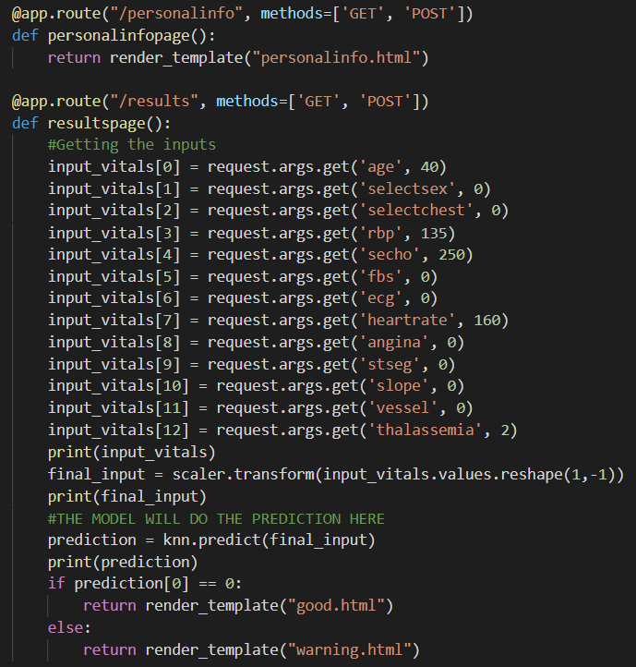
API (Flask)

Slide 8
User Interface HTML5 / CSS3
Notes:
You start from here, you can say I will explain the model and how does it makes the decision

Slide 9
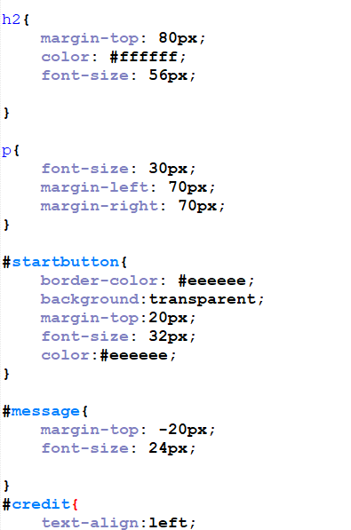
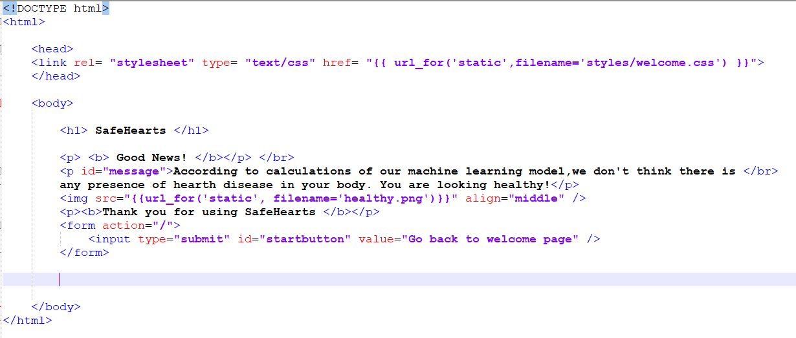
HTML5 & CSS3

Slide 10
Model How does it decide?
Notes:
You start from here, you can say I will explain the model and how does it makes the decision

Slide 11
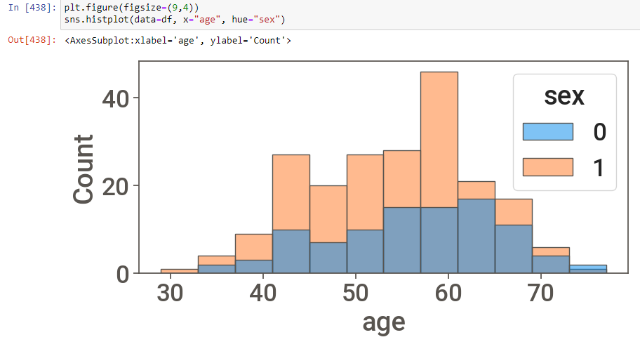
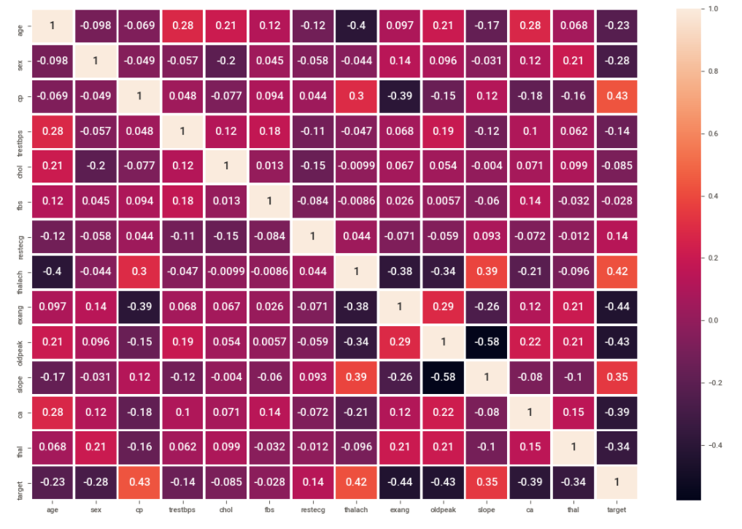
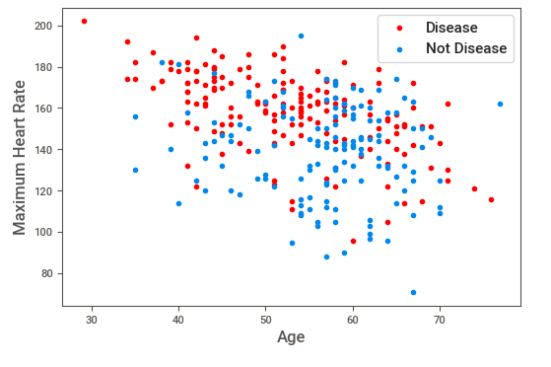
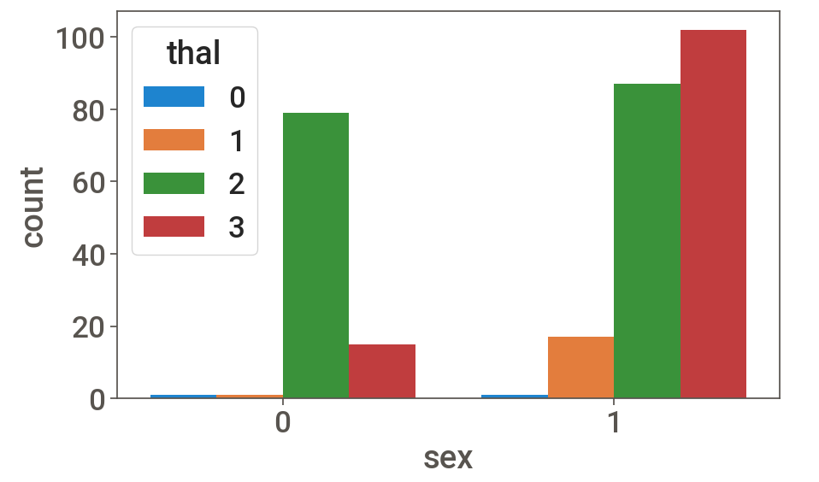
Exploratory Data Analysis
Notes:
In here just shortly mention you did the EDA. What you used and stuff

Slide 12
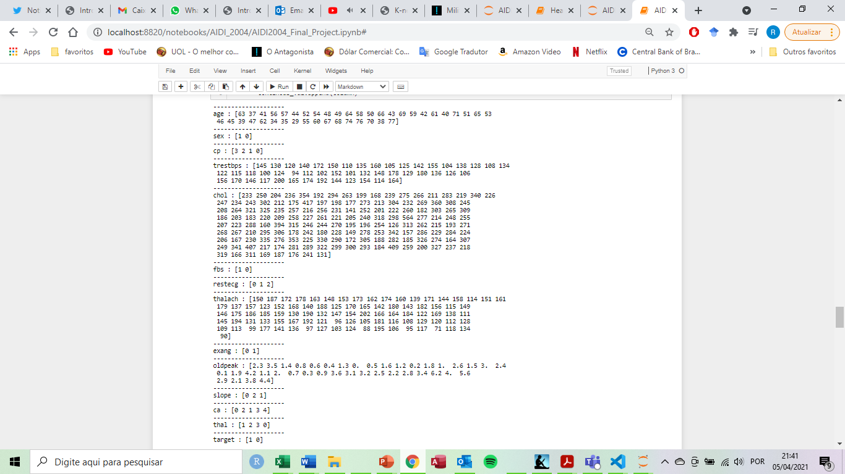
Feature Engineering

Slide 13
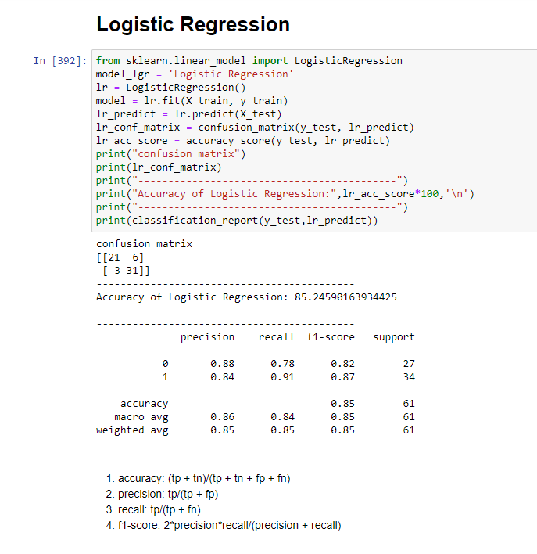
Algorithm Evaluation

Slide 14
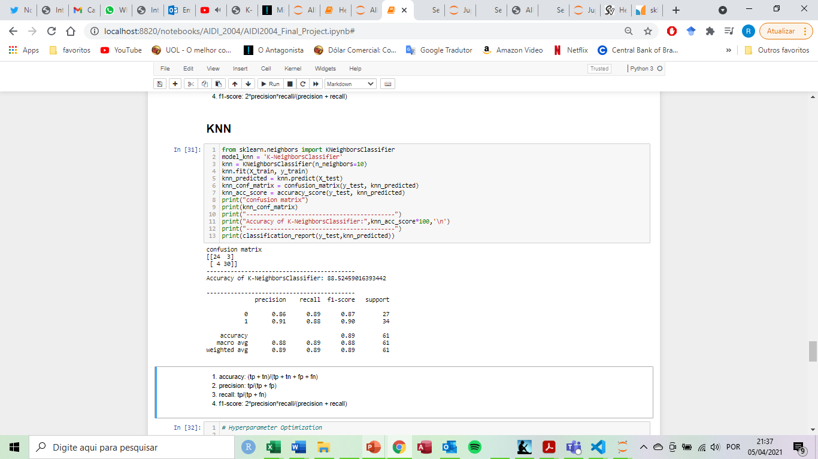
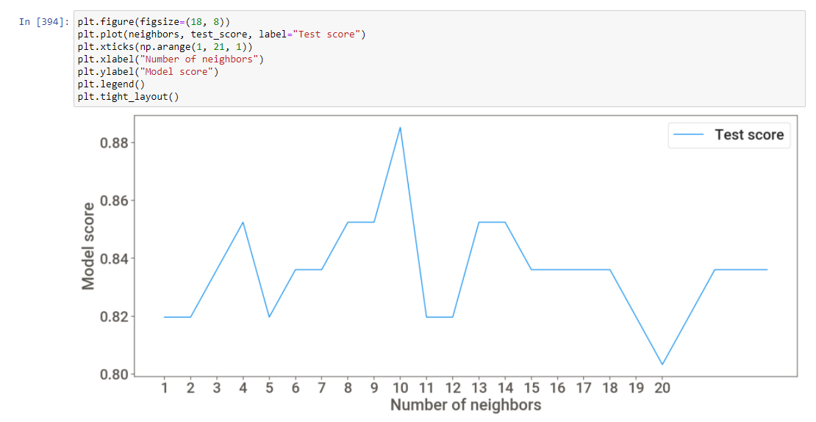
Algorithm Evaluation

Slide 15
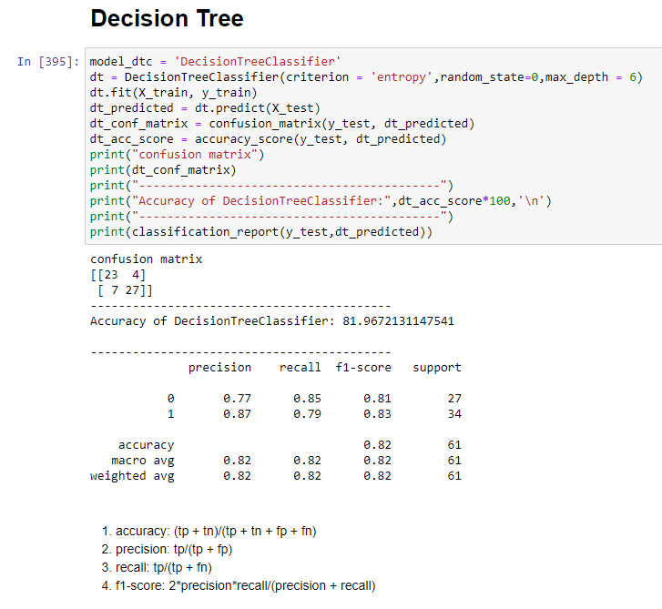
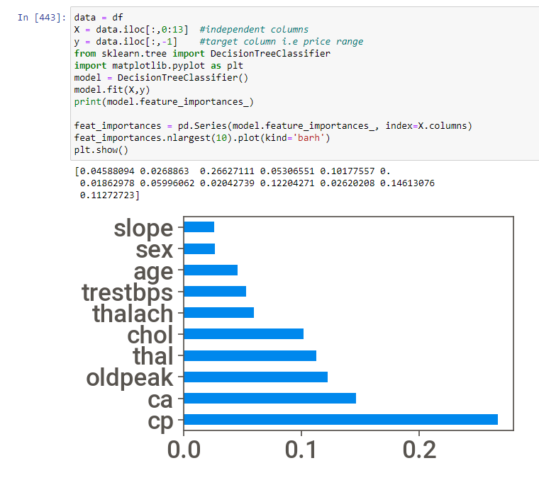
Algorithm Evaluation

Slide 16
Findings
The KNN model has the best level of accuracy, totaling 89%.
However, it is worth saying that the recall of the Logistic Regression model is 91% while the recall of the KNN model is 88%.
Therefore, as in this case it is very important to minimize the number of patients with cardiac condition who are classified as a healthy person, we considered picking the Logistic Regression model as well.

Slide 17
Deployment Github & Docker
Notes:
You start from here, you can say I will explain the model and how does it makes the decision

Slide 18
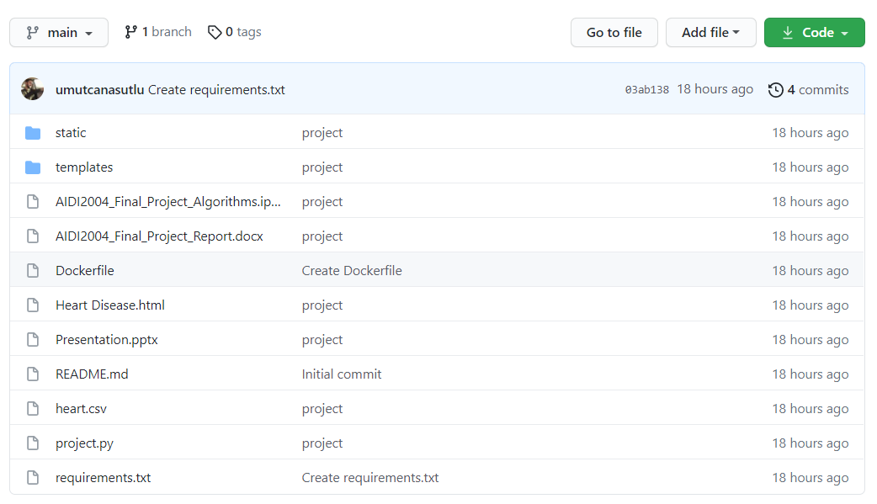
Github
Access Link: https://github.com/umutcanasutlu/aidi2004-final-project

Slide 19
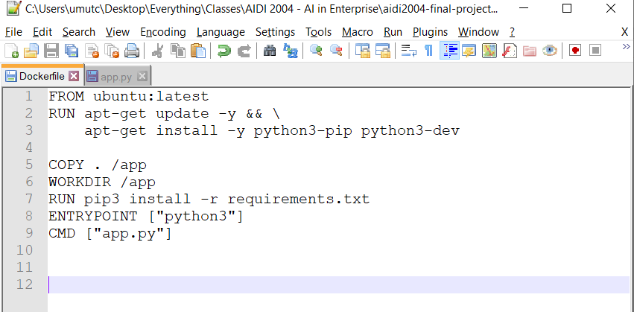
Docker

Slide 20
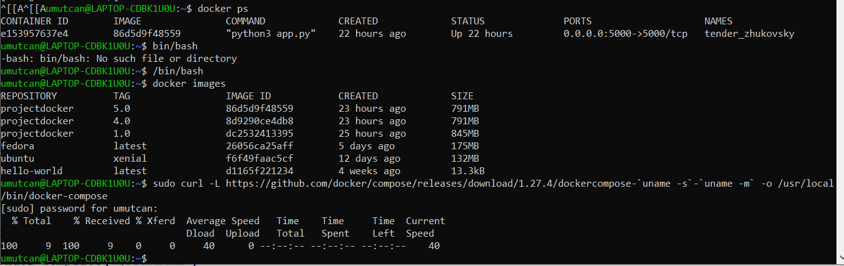
Docker

Slide 21
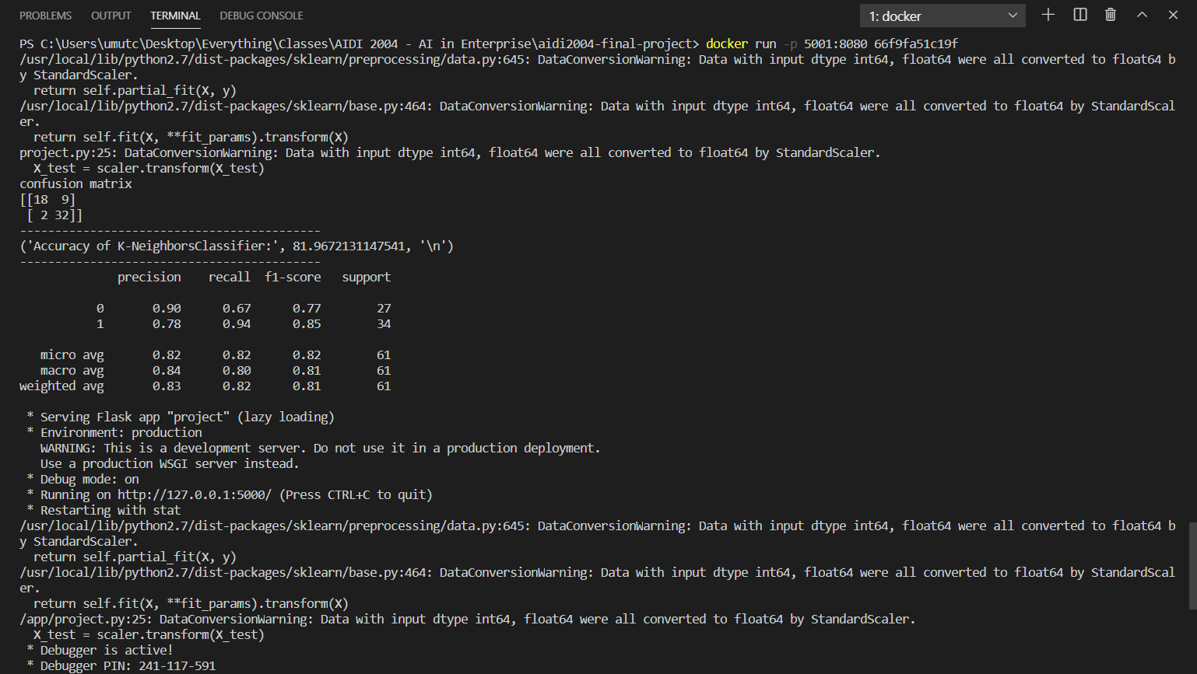
Docker

Slide 22
Division of Workload
Task | Member
Flask and UI | Umutcan
Machine Learning & EDA | Ramon
Docker | Umutcan
Report | Ramon
Presentation | Umutcan
Presenting | Together

Slide 23
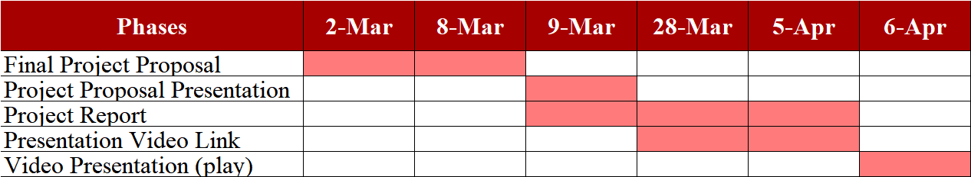
Project Plan

Slide 24
Thank you for your attention

